Slide 1
Data Analysis of Manhattan Neighborhoods – Restaurants
Pradeepa Jayachandran

Slide 2
Restaurant Feasibility
Objective
Analyzing NYC public data to look for the ideal neighborhood and restaurant type for maximum success
Problem Statement
With multiple Boroughs, Neighborhoods and large number of restaurant types – identifying the right neighborhood and restaurant type is a challenge

Slide 3
Data Source & Cleaning
NYC data for top neighborhoods based on Median sale price, number of transactions and y-o-y change
Filtered data to identify the top 10 expensive neighborhoods in Manmhattan
Added Lattitude and Longitude information using Geocode
Used foursquare API to get the top 100 venues for each neighborhood
Filter venue categories to restaurants

Slide 4
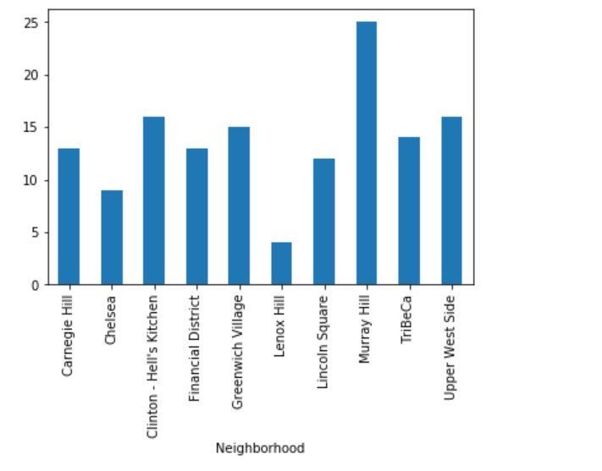
Lenox Hill & Chelsea have least restaurant diversity
Murray Hill seems to be saturated with multiple types of restaurants – Not ideal for new venture
Lenox Hill and Chelsea lack variation in cuisine – opportunity

Slide 5
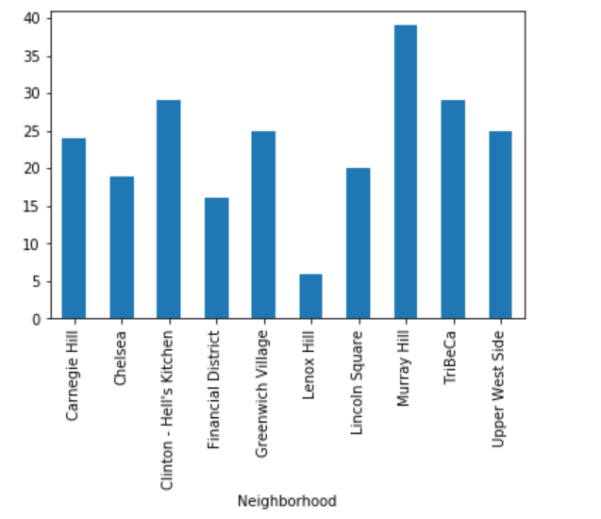
Lenox Hill has least number of restaurants
Murray Hill has largest number of restaurants – Not ideal for new venture
Lenox Hill has least number of restaurants – opportunity

Slide 6
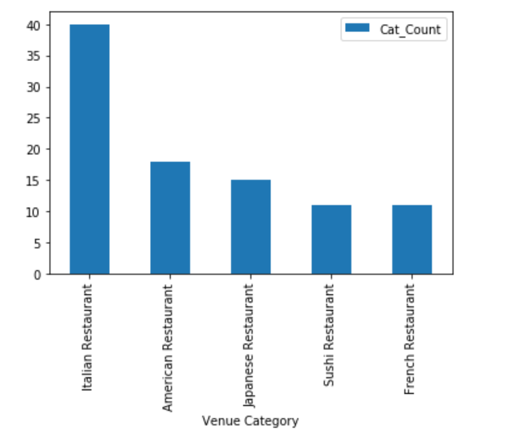
Italian and Japanese are the most popular category of restaurants
Italian and Japanese are most represented type of restaurant, followed by American and French
Other restaurant types are less prevalent

Slide 7
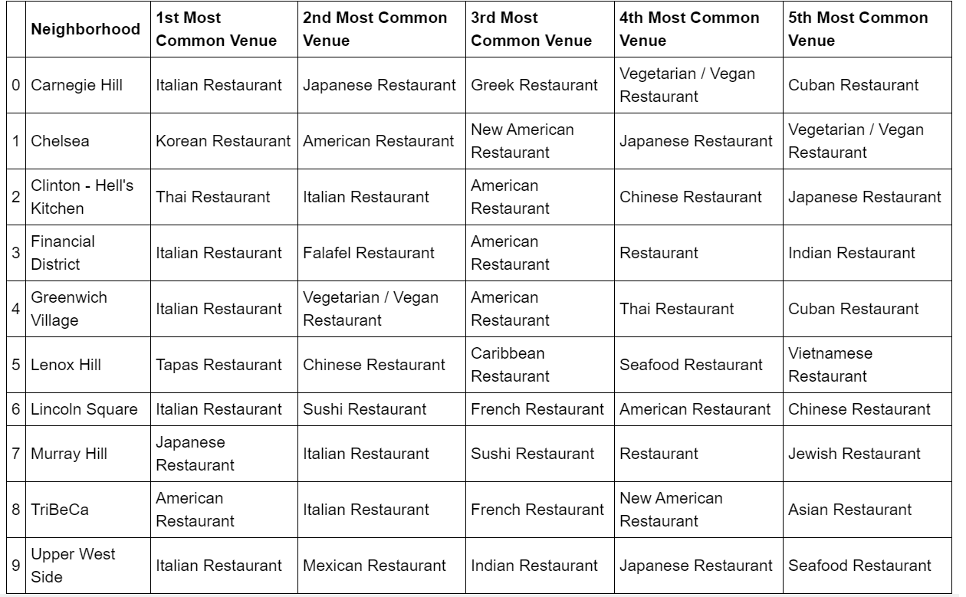
Most common restaurants in the top 10 neighborhoods of Manhattan

Slide 8
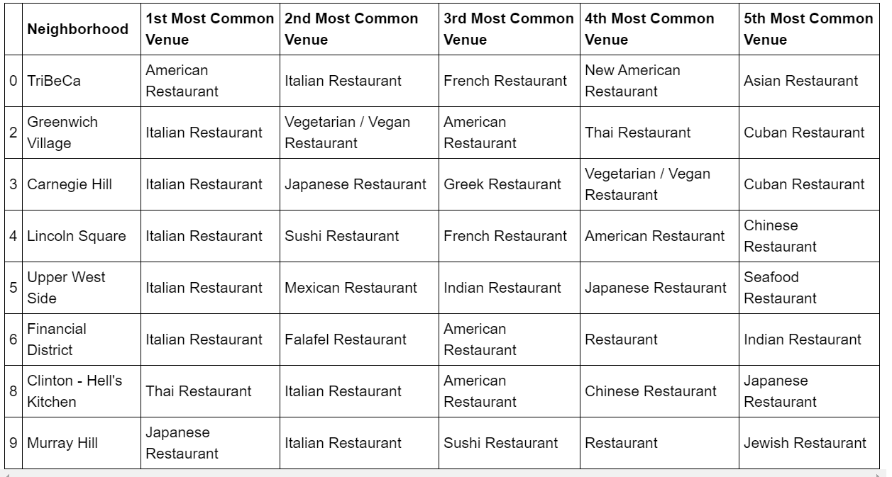
Machine learning (k-means clustering)
Cluster 1
The first cluster combines neighborhoods which have a trend of being filled with the most restaurants and most popular restaurant types. Italian and Asian restaurants were the most popular types in this cluster.

Slide 9
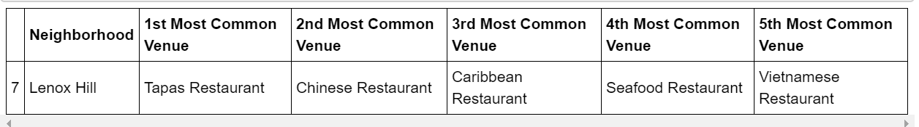
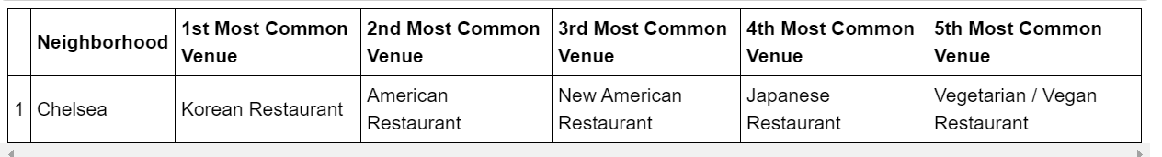
Machine learning (k-means clustering)
Cluster 2
Cluster 2 picked the neighborhood with the least restaurants and the least representation of the popular restaurants
Cluster 3
Cluster 3 picked the neighborhood with a representation of mostly restaurants from the lesser popular categories

Slide 10
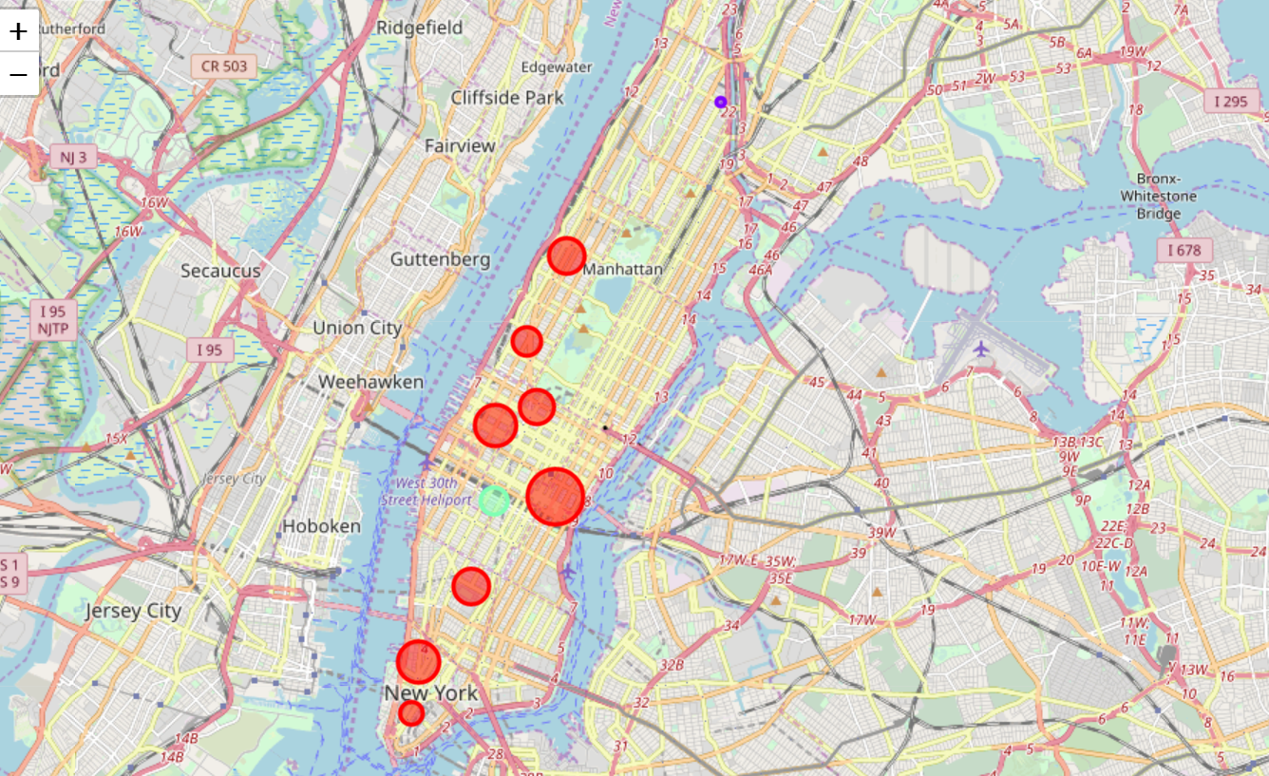
Visualization of Clusters – Folium map
Radius of Circle represents the number of restaurants in the neighborhood

Slide 11
Conclusion & Recommendation
The clustering from the machine learning algorithm is well aligned with the detailed analysis done on the data. The data clearly shows the following two observations for any potential investor
Recommendation
Lenox Hill has the least number of restaurants, least diversity in restaurants and has less representation of the popular categories (Italian, Japanese, American and French)
Chelsea has a good number of restaurants, but is less represented for the most popular category – Italian

